Slide 1
Find A Car Park
By Ido Shapira, Noa Aizer, Shay Leyzerovich

Slide 2
Introduction
Since the traffic congestion on the road, the problem of finding parking is one of the most common problems that drivers face on a daily basis.
The solution for the problem, is vital for every municipality which want to increase the quality of life of its residents. Municipalities are trying to solve this problem with non-technological solutions.
We propose a free parking detector method based on a deep learning approach named Convolutional Neural Network(CNN) .
The model would learn the pattern of full and free parking spots in different conditions i.e number of cars, lighting etc.

Slide 3
The dataset
Since Machine Learning(ML) methods require a data-set, we collected suitable data-set from the Kaggle website*.
The dataset contains 2.57GB of cars parking spots images divided to 1067 images that contains free and available car parking and 2195 that contains full and unavailable parking spots.
We normalized the images and resized them to 160 x 160.
* www.kaggle.com%2Fdaggysheep%2Ffind-a-car-park

Slide 4
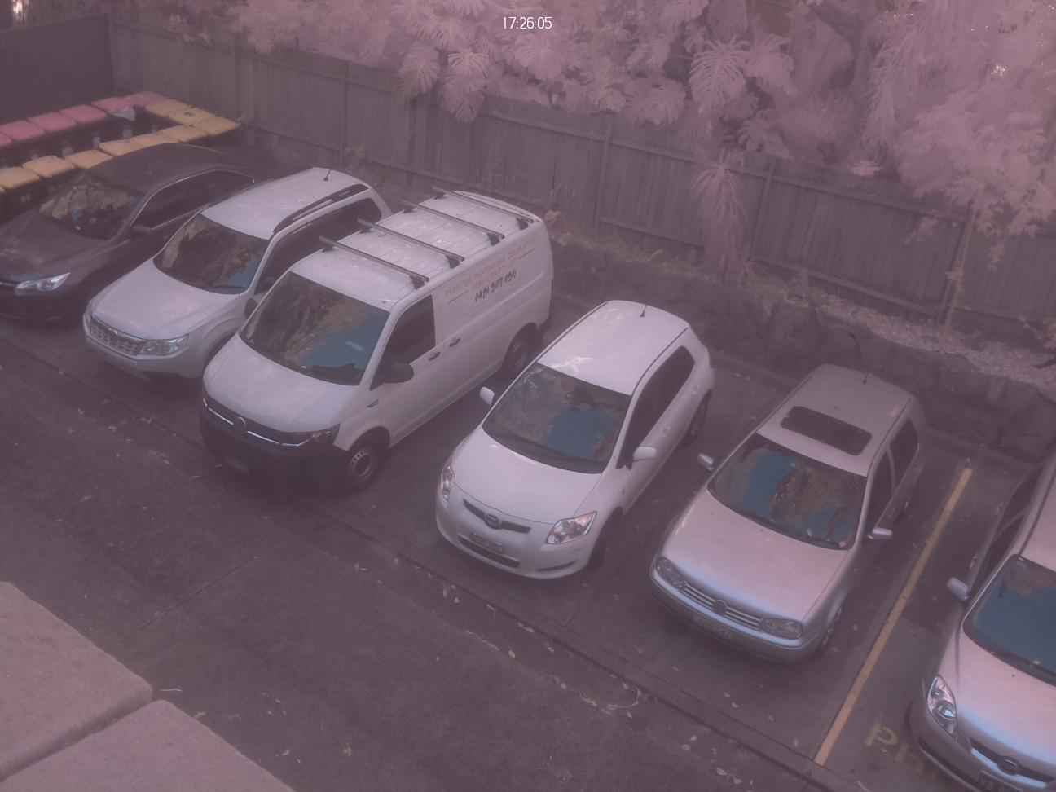
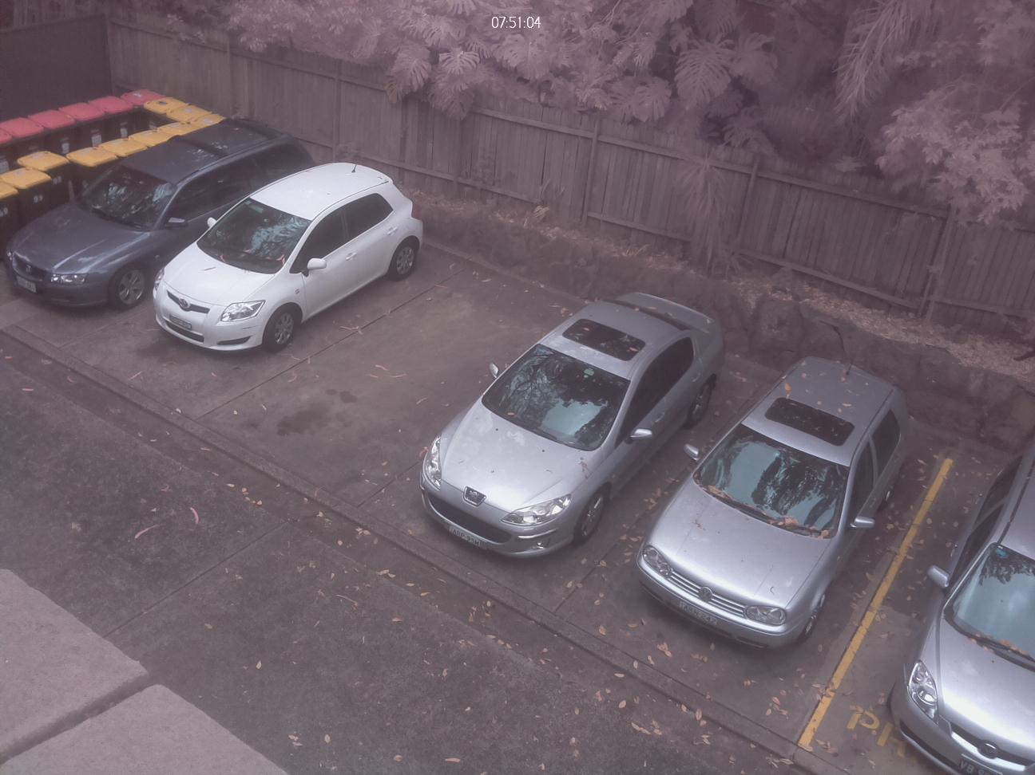
We divided the data-set into two parts: 80% for training, 20% for testing.
 | Training dataset | Testing dataset | Total
Free | 863 | 204 | 1067
Full | 1746 | 449 | 2195
Full
Free

Slide 5
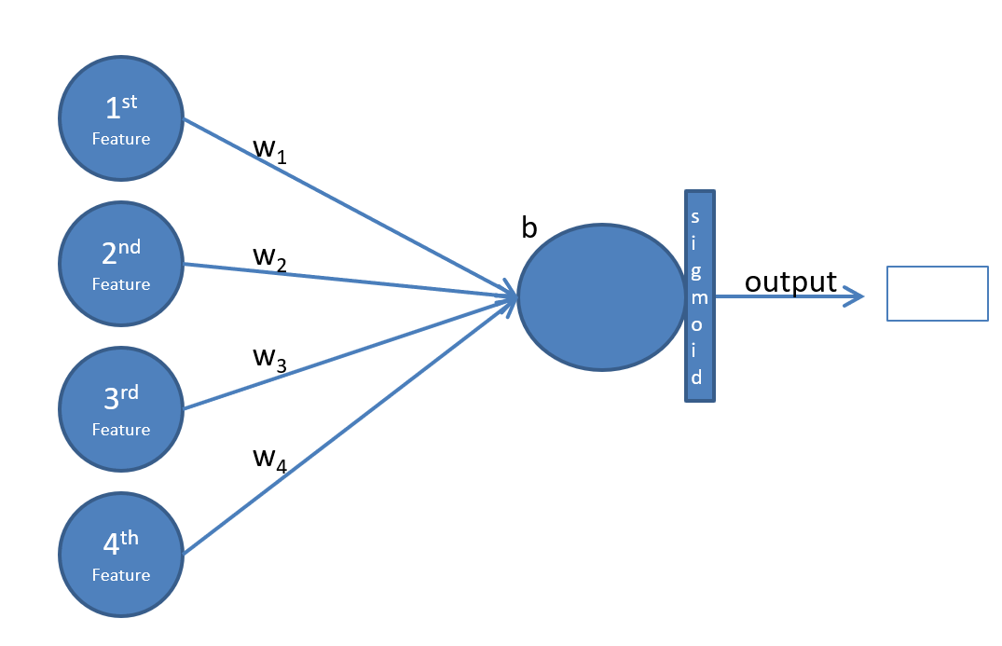
First attempt - Logistic regression
We built a Logistic Regression model. We determine the result using sigmoid function. The loss function is the sigmoid cross-entropy function, and eventually updated the model using the gradient descent optimizer.
The model has the following parameters:
Learning rate = 0.003
Number of iterations = 850
Batch size = 128
The model had an accuracy of 89% on the testing set after optimization and training the data.
Credit: Dr. Amos Azaria

Slide 6
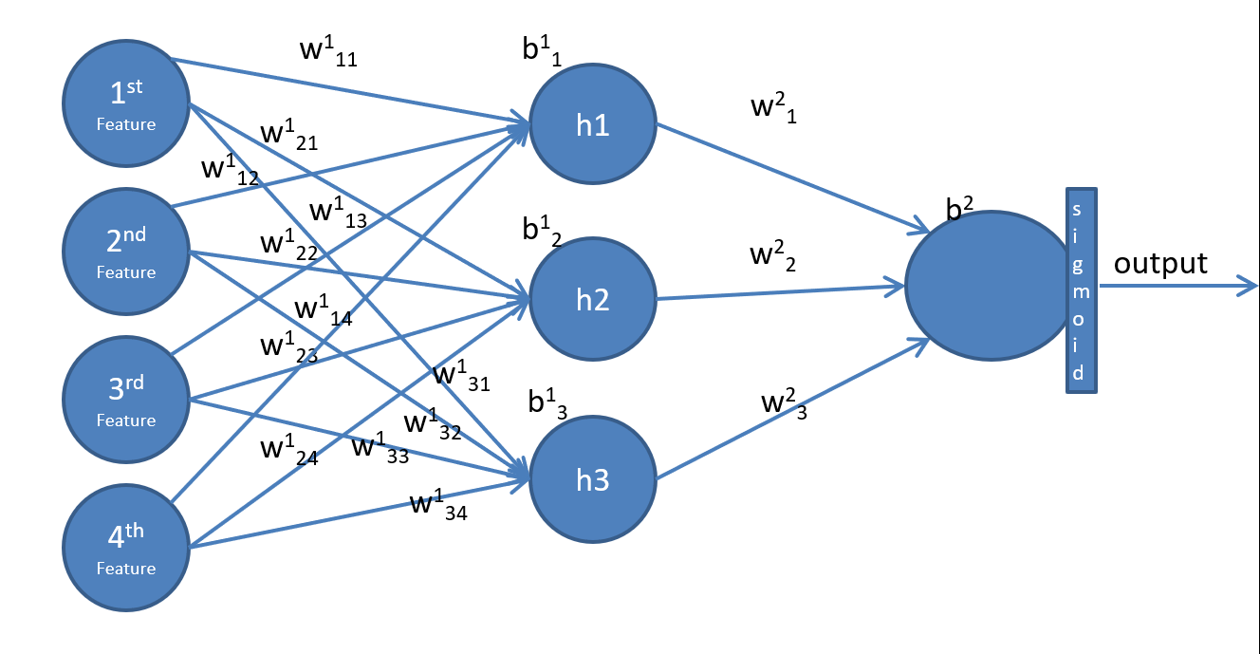
Second attempt - MLP
We built a MLP model using the same loss function, optimizer and learning rate as in the Logistic Regression model. The main difference was adding two hidden layers - the first with 128 neurons, and the second with 256 neurons. We used the Relu function as the activation function.
The model was trained over 650 iterations
with batch size same as the logistic model.
The MLP model had an accuracy of 96% on the testing set after optimisation of the network and training using the Gradient Descent and BP.
Credit: Dr. Amos Azaria

Slide 7
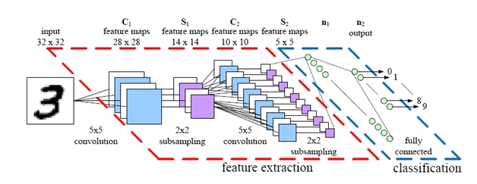
Third attempt - CNN
We built a CNN model containing two convolution layers and fully connected layer at the end. In the two layers we used the relu activation function and 2x2 Max-Pooling for sub-sampling.
The first layer had 32 kernels with size 5x5.
The second layer had 64 kernels with size 3x3.
A fully connected layer containing 1024 neurons for flatting the matrix.
The training was over 440 iterations with
learning rate 0.001 and dropout with keep
probability of 80%.
The model had an accuracy of 98% on the
testing set after using Adam optimisation
and training of the data.
Credit: parse.ele.tue.nl

Slide 8
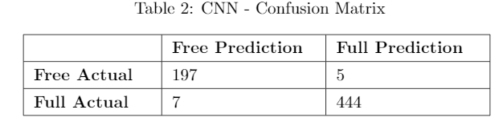
Best model results (CNN):
The final best result we have achieved was on the entire RGB images using the CNN model that reached an accuracy of 98%.
The confusion matrix for the CNN model ("Free" defined as the Positive value):

Slide 9
Result - scores:
Extract the following scores from the confusion matrix:
Accuracy = 98%
Precision = 97.52%
Recall = 96.56%
F1-Score = 97%
We can conclude from the Recall and the Precision scores that when the CNN model tried to predict an image as "free", it succeeded in 97.52% of the time, but there was a drop at classifying the "free" images as "free" (96.56% of the images).

Slide 10
Conclusion
In this project, we present a novel technology approach for solving the car parking problem using deep learning. We attempt to build a model that by given using street-camera's images, detects the images with the free parking spots.
First, we trained a logistic regression model in order to get base results. Then we trained a MLP and Convolution Neural Network(CNN).
The best results were obtained by the CNN model with 98% of accuracy.
Future work idea is to build an application that connects to a street camera and notifies the driver if there is a parking spot next to his house and perhaps obtain more diverse data.

